Slide 1
MEN WITH INFLUENC PROGRAM
BY: SHEQUITE JOHNSON
Present to: Dr. Cynthia Shelton
PPAD 782
Jackson State University
November 6, 2020

Slide 2

Outline
PROGRAM OVERVIEW
Program hypothesis/intervention
PROGRAM NECESSITY
Proposed outcomes and impact
GOALS AND OBJECTIVES
EVALUATION
CONCLUSION
BIBLIOGRAPHY

Slide 3


PROGRAM OVERVIEW
Men with Influence targets men of color with children that has been incarcerated for a period of three years or more.
Program aims to reconnect fathers with their children after imprisonment.
Date suggest that the absence of a father within the African American community is high, with over 19 million children living in homes without a father, according to a Census Bureau report in 2005.
It has been proven that at least 56 percent of black children are residing in single-parent families lead by women.
More than half of fathers in state prison report being the primary wage-earner in their family.
Attempt to closing the GAP regarding other issues associated with fathers being absent from their children, such as improving their intellectual and emotional growth.

Slide 4
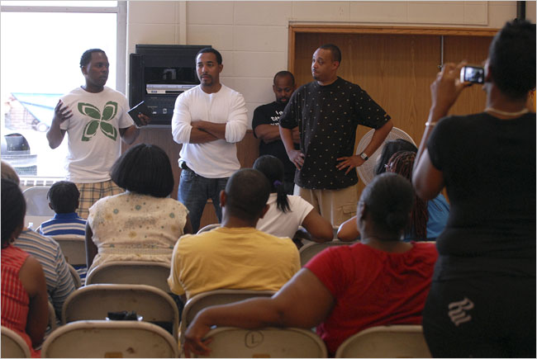

Program hypothesis/intervention
Men with Influence will supply the tools and resources needed to address the emotional pain African American children experience due to a father's absence. After interventions:
  At least 50% of the men that enroll in Men with Influence Program will have reconnected with their children within the first year while receiving the tools and resources needed to start building on positive relationships.
  At least 20% of the fathers within the program will begin training other men to become Men with Influence.
The program will be self sustainable:
  Train fathers who complete the program to become mentors to other fathers that enter the program.
  Collaborate with churches for support, mentors, volunteer opportunities.

Slide 5

PROGRAM NECESSITY
How will these needs be addressed?
Help fathers become aware of the critical roles fathers need to play.
Help fathers make familial relationships better depending on their circumstances.
Follow-ups to ensure the proper tasks are being implemented to increase positive and long-lasting relationships.
Provide additional research
Determine any significant changes after the previous activities are complete.
Offer therapy or counseling for children and fathers if needed.
Provide mentorship from other father.
  These mentors will go through a screening process and service will be voluntary. This structure will allow the program to run with little to no cost while being sustainable and operational fully through volunteering.
At least 56 percent of black children are residing in single-parent families lead by women. That is a very alarming number.
More than half of fathers in state prison report being the primary wage-earner in their family. This is the reason Men with influence is so essential and critical.
Supporting this program will have a long term effect, not only toward the child and father, but the society as well.
Data has proven time after time the impact a father can have on a child. Men with Influence will help nature those relationships.

Slide 6
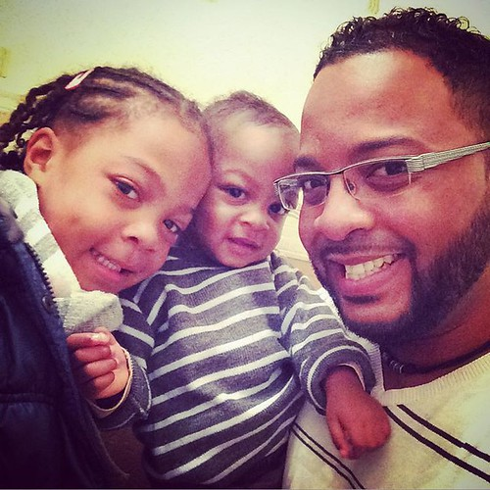
PROPOSED OUTCOMES AND IMPACT
Many black fathers lack realistic role models and expectations. Men will influence will:
  Help fathers understand that their involvement has evolved over the years.
  Teach fathers to draw from things they liked about their fathers, strive to correct the habits that did not work, and pull other parents' examples.
Economics / Imprisonment change how fathers see themselves:
  Help fathers appreciate and value what they are doing.
  Teach them not to beat themselves up over what they cannot do.
  Fathers will define what "involved" means to them, depending on their circumstances while understanding what involve means in their case. This will help them live up to the right ideals that fit their unique circumstances.
  Partners and mentors who work with fathers, such as counselors, can support fathers by reminding them of their needed contributions.
  Provide encouragement.
Community Support:
  Fathers will take more responsibility for building community.
  Collaborate with the churches within the community.
  Seek aid from community to support program efforts.

Slide 7

Goals and Objectives
Men with Influence will help fathers to be better parents through:
  Individual and family counseling
  Mentoring and Support
  Therapeutic activities for children
Our goals are as followed:
  Empower fathers
  Emphasize the importance of fatherhood
  Increase the likelihood of fathers developing and maintaining a relationship with their children.
  Foster youth development socially, emotionally, and psychologically.
  Develop leadership amongst father
  Addresses opportunity gaps

Slide 8
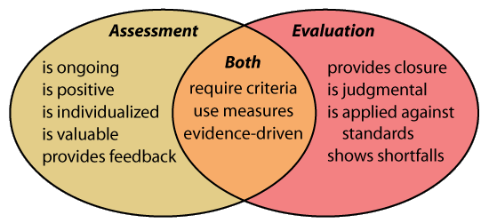
EVALUATION
Men with Influence Program will have two types of evaluations – formative and summative.
Formative
  The first will ensure that the program is being implemented according to the specified design.
Summative:
  The latter will focus on the outcomes designated by the program and if the program accomplished the stated goals.
Workshops and activities will help fathers understand the impact of their presence in their children's lives.
  Evaluation of their learnings from all activities and workshops will be monitored weekly.
  There will be a "final test" conducted in order for researchers and the local community to see if there are significant changes within the father and child's relationship.
  Additional research will be used to follow through with the previous plans.
After one year within the program, a survey will be conducted, and an interview will be done to evaluate if the previous activities were significant.
  These evaluations of activities would give the researcher data if the objectives were met and significantly change the lives of these families, which is the goal in the first place.
  Therapy and counseling will be provided for individuals that require it. Counseling will help guide families towards continued growth and will maintain their development throughout time.

Slide 9
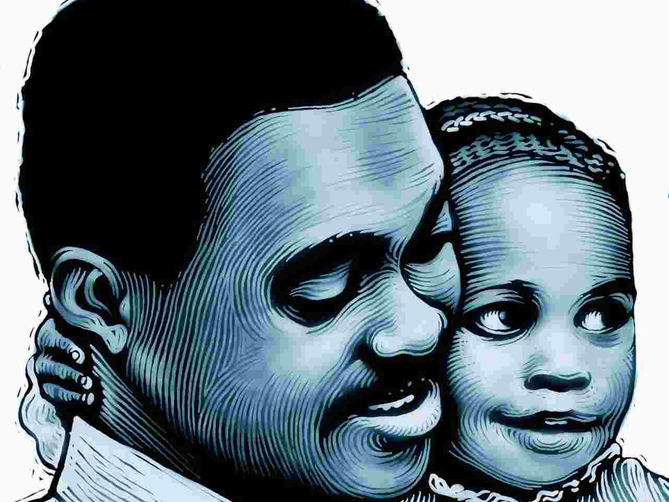
CONCLUSION
The presence of nurturing fathers will profoundly impact the lives of children’s health and well-being when participating in the Men with Influence Program. “Men with Influence” will lower the absence rate of BLACK fathers in the lives of African American children. Men of Influence will increase positive relationships amongst father and child, aiding fathers to become productive citizens, and assisting men to become mentors to other young men.

Slide 10
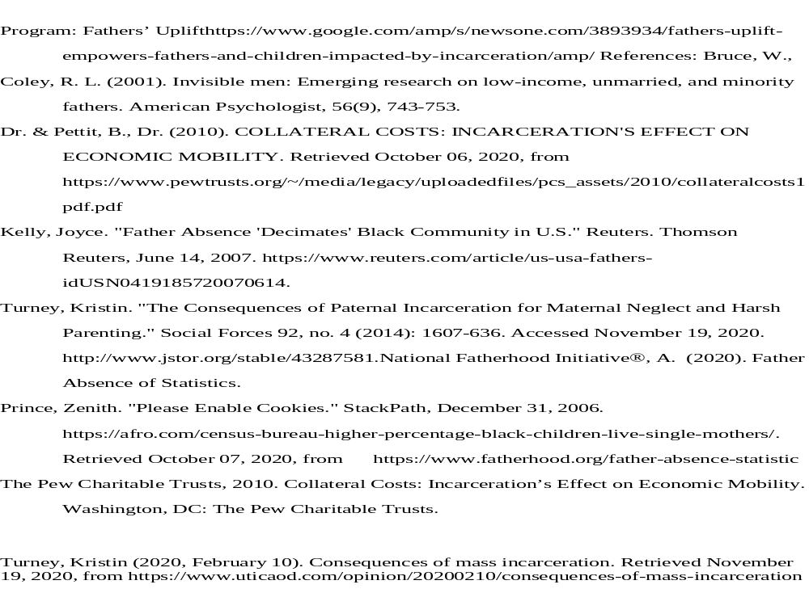
BIBLIOGRAPHY

